Slide 1
Financial sentimental analysis
Project 203- Group 1
Project Guide
Ms. Neha Gupta
Team Members
Balaji Nagarajan
Diwakar Murugan
Ch Aswanth Reddy
Yerra Venkata Gireesh Chandra
Vaishnavi Sunil Thalkar
Mohammed Akram
Project Co-ordinator
Ms. Deepika

Slide 2
Business objective
Need to get sentiment analysis of financial statements and gauge its impact
i.e. positive, negative neutral
Architecture level analysis:
1. Data transformation/Text processing using R/Python
2. Need to get sentiments Analysis and Emotion mining with some charts like histogram, Density plot, Bar plot, pie-plot etc.
3. Deployment through R Shiny or Flask/ Streamlit

Slide 3
Dataset
Financial sentiment analysis datasets contain a collection of financial news articles, social media posts, and other textual data related to the financial industry.
The dataset contains labeled data, which is classified as positive, negative, or neutral sentiment, allowing for the training of machine learning models.
It consists of 5842 rows and 2 columns(Sentence and Sentiment)

Slide 4
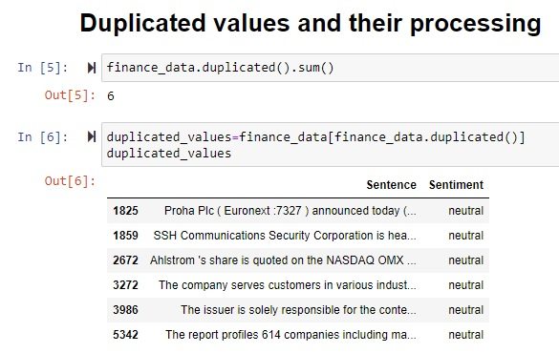
Pre processing
Checking for the duplicated rows
6 duplicated rows with same emotions are removed
514 rows of same sentence but with different emotions have been identified
The actual emotion from the duplicated datas are found for best dataset

Slide 5
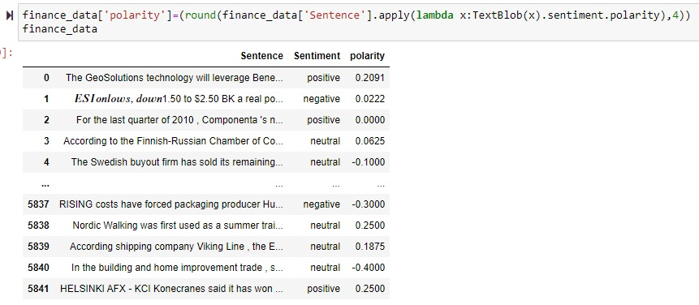
Polarity for emotions
Polarity score has been checked against each sentiment
From these scores we cannot attain at a sharp threshold limit for the polarity scores for the different sentiments
From the description we cannot make the abrupt threshold function since it is mixed up in the dataset

Slide 6
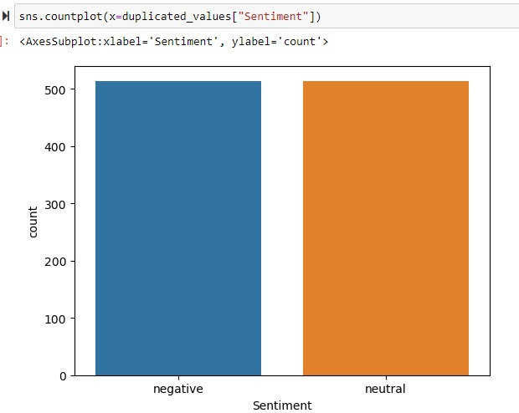
Visualization of duplicated sentiments
only the negative and neutral data is the issue here
Only these sentiments have been duplication for a corresponding sentence

Slide 7
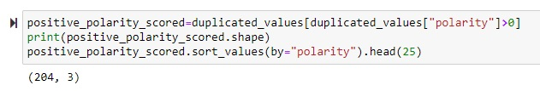
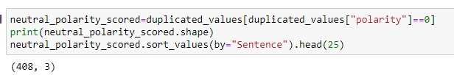
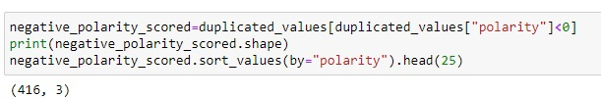
Segregating the sentiments
The sentiments have been segregated and checked
From using this Polarity Scores we can make a conclusion that the polarity scores less than zero can be classified as the negative sentiment
For the polarity score equal to zero can be concluded as neutral statements
But the statements with polarity score greater that zero cannot be easily concluded and there are 52 unique statements in such category
Hence for this but manually reading and understanding the statements we can make an assumption that that the statements having positive polarity scores are also negative in the sense of nature and hence the statements with polarity scores other than zero are to considered as Negative sentiments

Slide 8
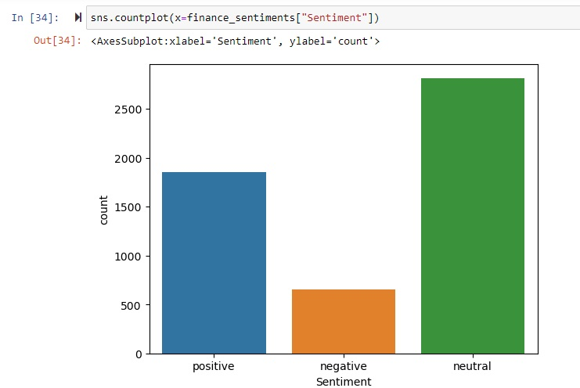
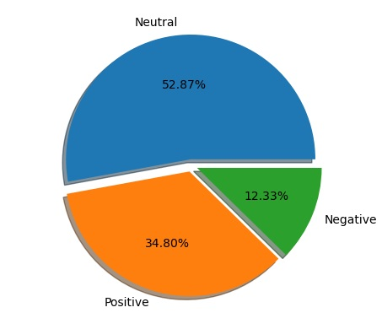
distribution of the dataset
From this plot ,we can see that the dataset is unbalanced , which means that the dataset does not provide almost equal number of cases for all the different types of sentiment that must be predicted
It is obvious that the Sentiment “Neutral” is the dominant one. Having an unbalanced dataset may lead us to
classifiers/models that can not identify and classify cases that belong to positive or negative Sentiments and they may misclassify them.

Slide 9
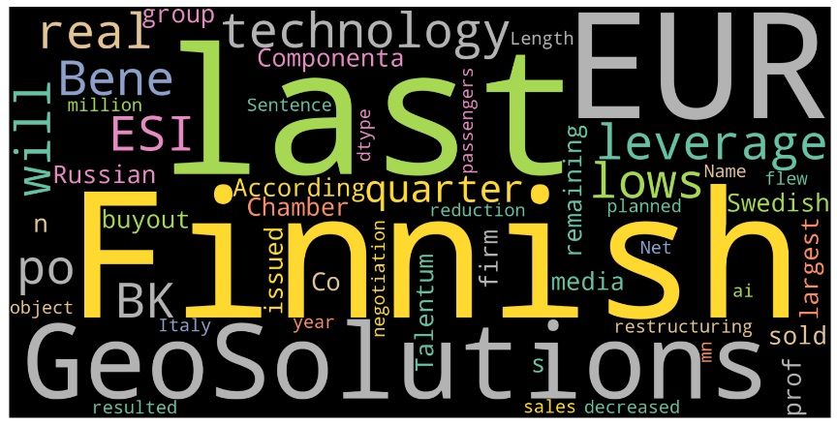
Word Cloud of unprocessed data
Viewing the word cloud and the dataset we can see the there are many links found in the text
Many currency names found in the sentences which does not influence the text
Many years and share values are reported comparing its previous years reports which cannot be used in sentiment analysis
Many measurements are found along with their units which do not contribute to the sentiments
There are many organization names and country names which cannot influence sentiments
Hence there are many symbols and some words with different cases we can carry over preprocessing of the data and then carry on these analysis part

Slide 10
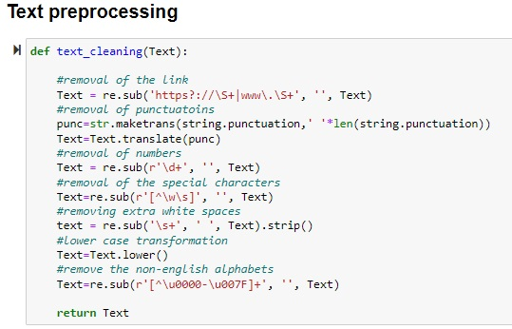
Text preprocessing
Links, symbols, punctuations, numbers, special characters, extra white spaces have been removed
All the texts are converted to lower case
Non-English alphabets have been removed

Slide 11
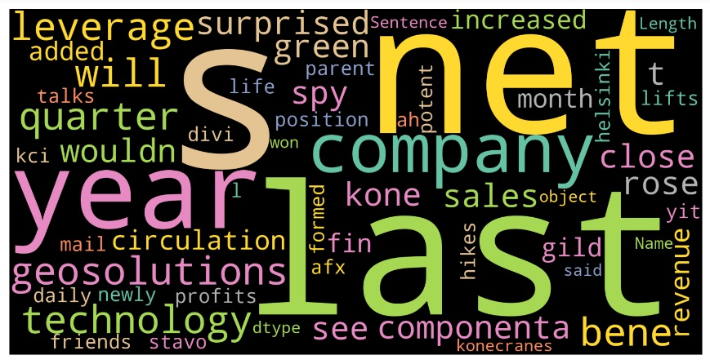
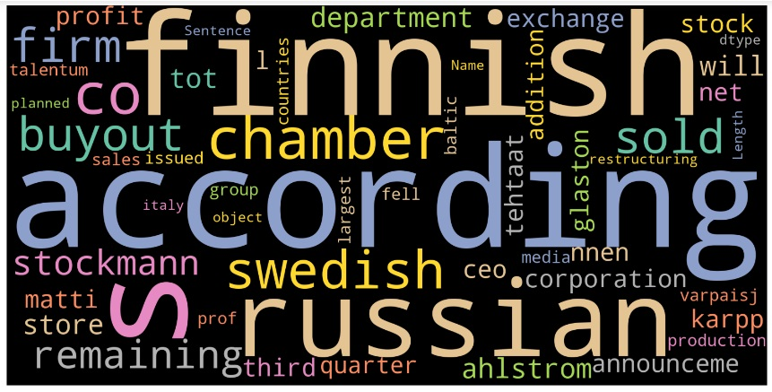
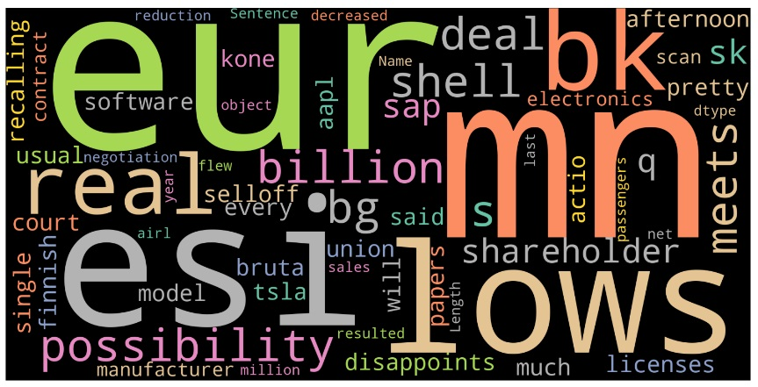
Word Cloud of processed data
Word cloud for processed data have been displayed here for different sentiments
After tokenization we can find the repeating words in the all the different sentiments
Then unique words in each sentiment is taken as list
POSITIVE NEUTRAL NEGATIVE

Slide 12
Observations from pre-processing
Viewing the output we can see that there are country names, brand names, currency names, share names and certain other domain specific words and also the words referring the time period are present in the dataset and also they do not contribute to mine the emotion as they can be present in all the sentiments
Also there are many stopwords to be removed from the dataset as they do not contribute to the emotion

Slide 13
N-Gram analysis
Before removing the stopwords from dataset we have to check the n-grams since there may be possibility that these stopwords may be contributing to the emotions when they are continued are followed by the other words
So Bigram and Trigram analysis have to be done

Slide 14
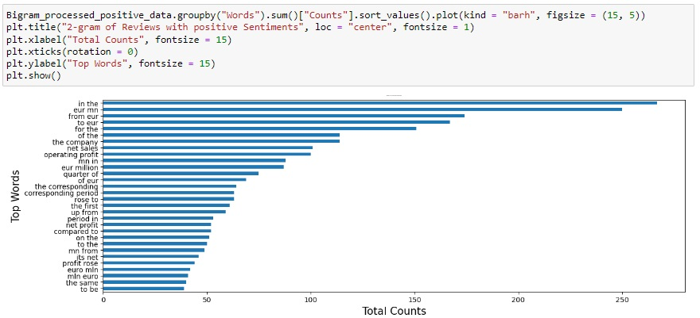
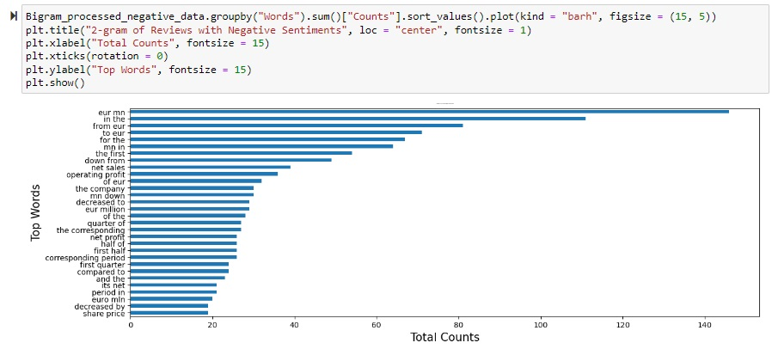
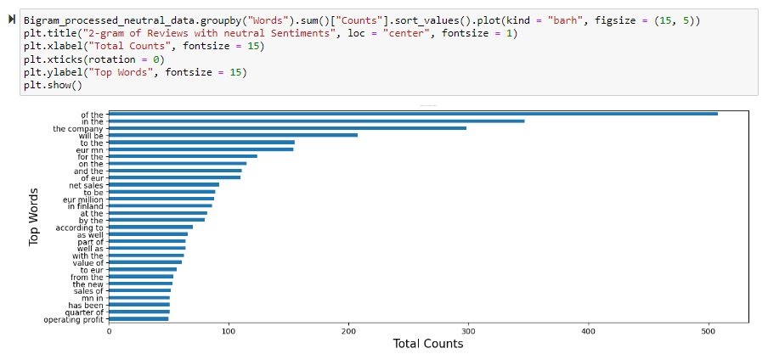
Bi-gram analysis
Bigram analysis for different sentiments have been plotted below
From this bigram analysis we can find that some words like
1. Even though profit is a common terms like Operating Profit, net profit is a domain specific term which is to be removed since it does not contribute to the sentiment
2. The most repeating bigram words are found to be currency or share names and words denoting the periodical specifications

Slide 15
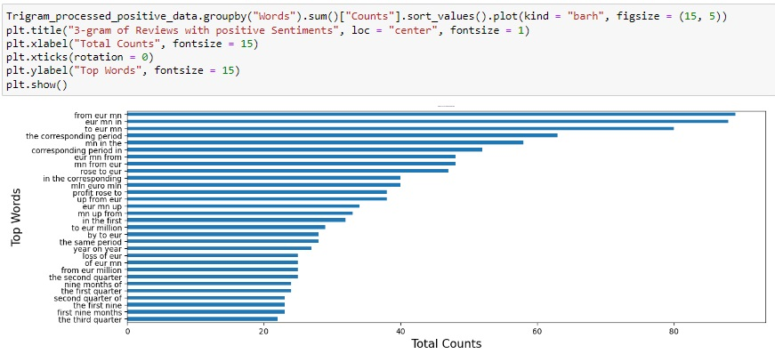
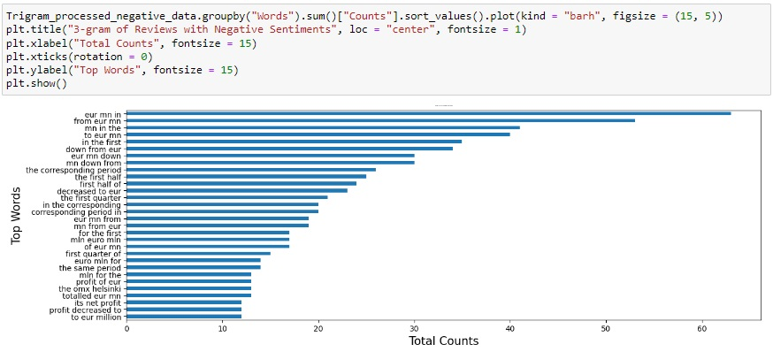
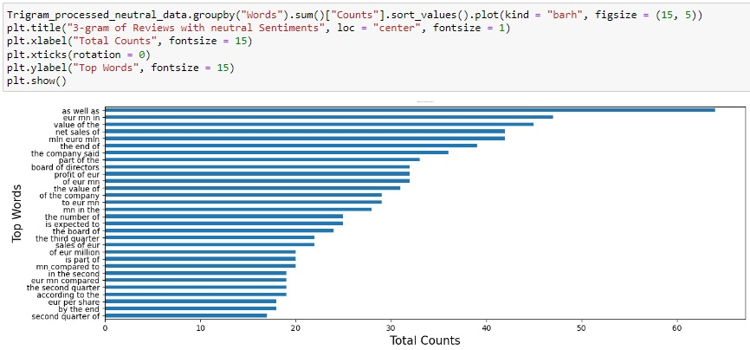
Tri-gram analysis
Trigram analysis have been done similarly for different emotions
The trigram analysis also shows the similar inference form the bigram analysis that most of the words are common English words and currency and some period related terms which do not contribute to the sentiments

Slide 16
Observations from n-gram analysis
From the analysis carried over we can find that the company names and period names and some of the common words are to be removed as they do not contribute to the sentiments , which infers that they may be present in sentences containing different sentiments
The domain words consists of the names of companies , currencies , terms referring period, and some share names and also some general words which do not contribute to the sentiments

Slide 17
since we have formulated the stopwords from the existing dataset
Now we have to remove these stopwords and for this since we are removing the stop words individually each word is tokenized that is each word split a single word
There is possibility that many of the words may present in different grammatical format and they are convert into their root words by the process of lemmatization
After Lemmatization, the processed cleaned data have been stored in a data frame named ‘processed_Financial_dataset.csv’

Slide 18
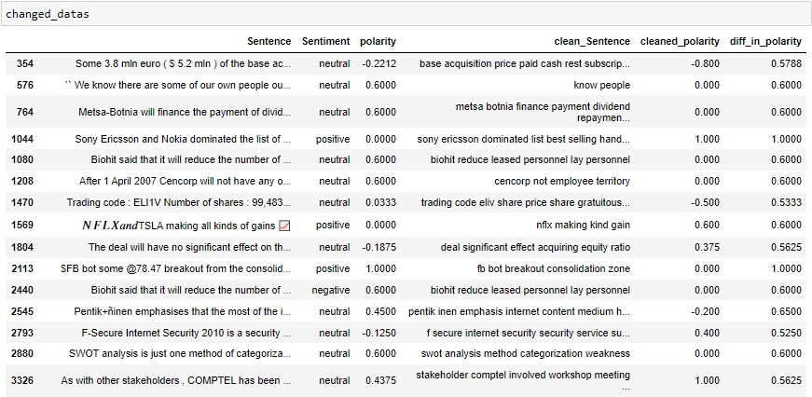
Checking for the polarity score between the cleaned data and uncleaned data
Polarity using textblob has been found for cleaned data and checked against the polarity score for uncleaned data with the difference between them.
By reading the difference in the polarity score between the statements manually for the statements making bigger difference we can find the change in the polarity score is in manner that the sentiments are not changed

Slide 19
Model building
Model
Unbalanced Data
TF-IDF
SVM
Random Forest
Multinomial NB
Word2Vec
XGBM
Random Forest
Balanced using SMOTE
TF-IDF
SVM
Random Forest
Multinomial NB
Word2Vec
XGBM
Random Forest

Slide 20
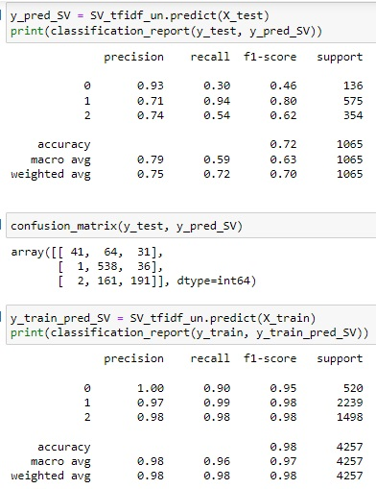
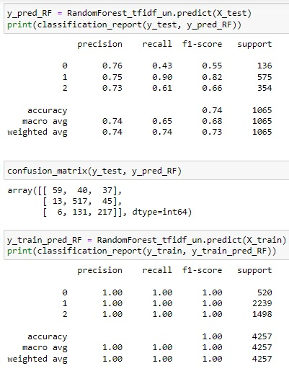
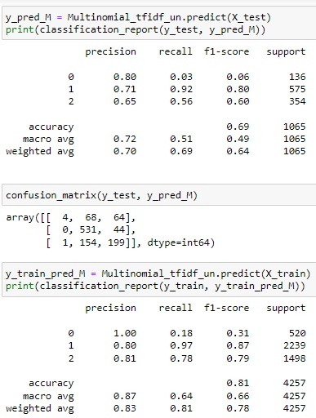
UNBALANCED : (1)TF-IDF
SVM with TF-IDF Random Forest with TF-IDF Multinomial Naïve Bayes

Slide 21
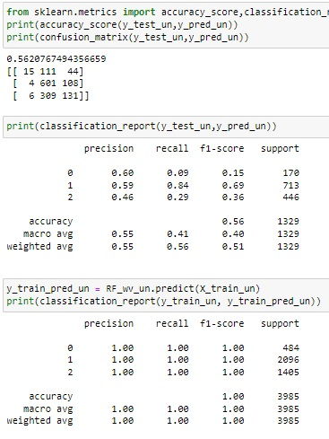
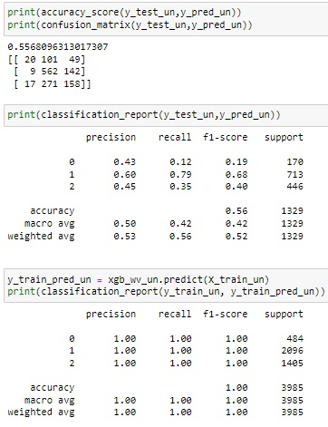
UNBALANCED : (1I) word2vec (gensim)
Random Forest XGBM

Slide 22
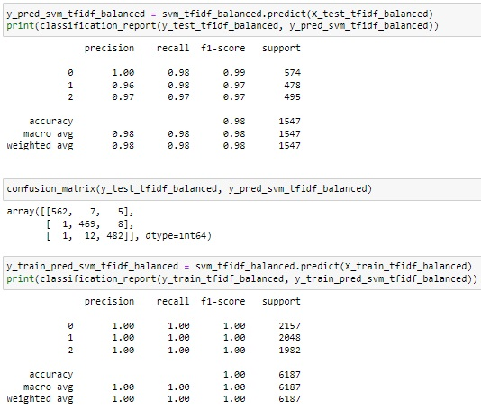
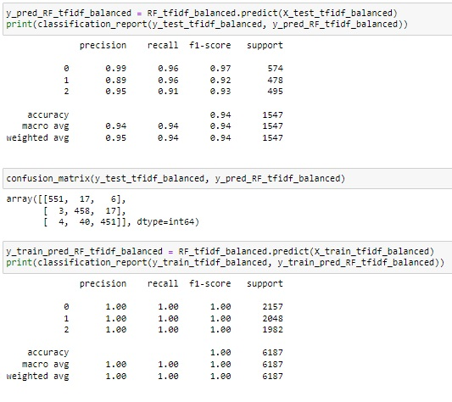
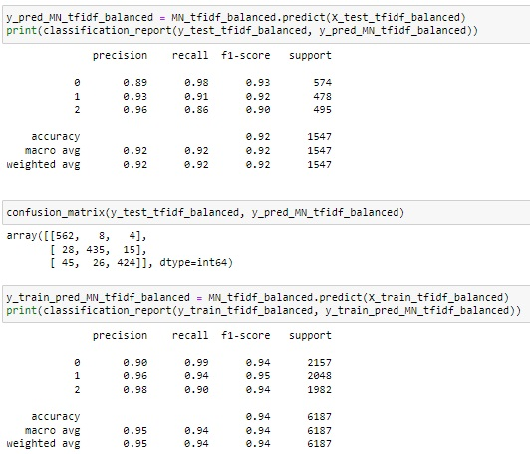
Balanced data using smote enn (I) TF-IDF
SVM with TF-IDF Random Forest with TF-IDF Multinomial Naïve Bayes

Slide 23
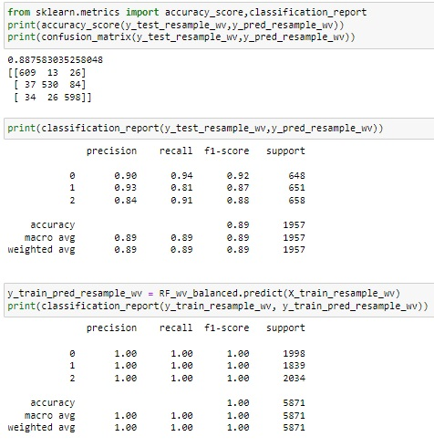
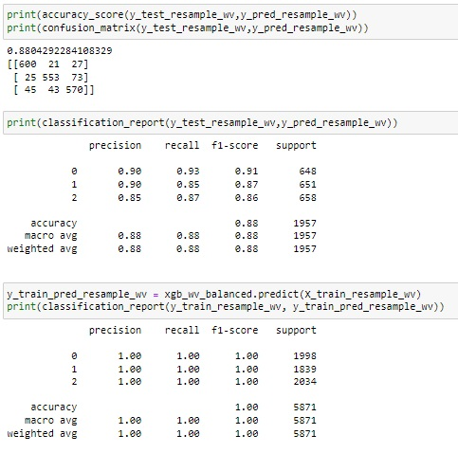
Balanced data: (1I) word2vec (gensim)
Random Forest XGBM

Slide 24
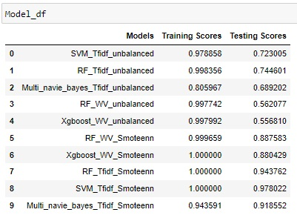

Model Dataframe
By comparing all the models it is found to perform well in the training dataset but the testing accuracy is not at a good level
With unbalanced dataset the best testing accuracy we can obtain is 74% but we can improve the accuracy by carrying out SMOTEENN
After SMOTEENN Random forest model is well performing in Word2vec and Tf-idf models
But SVM model with TF-idf is performing better and hence we are finalizing the Random Forest Model with Tf-idf vectorizer

Slide 25
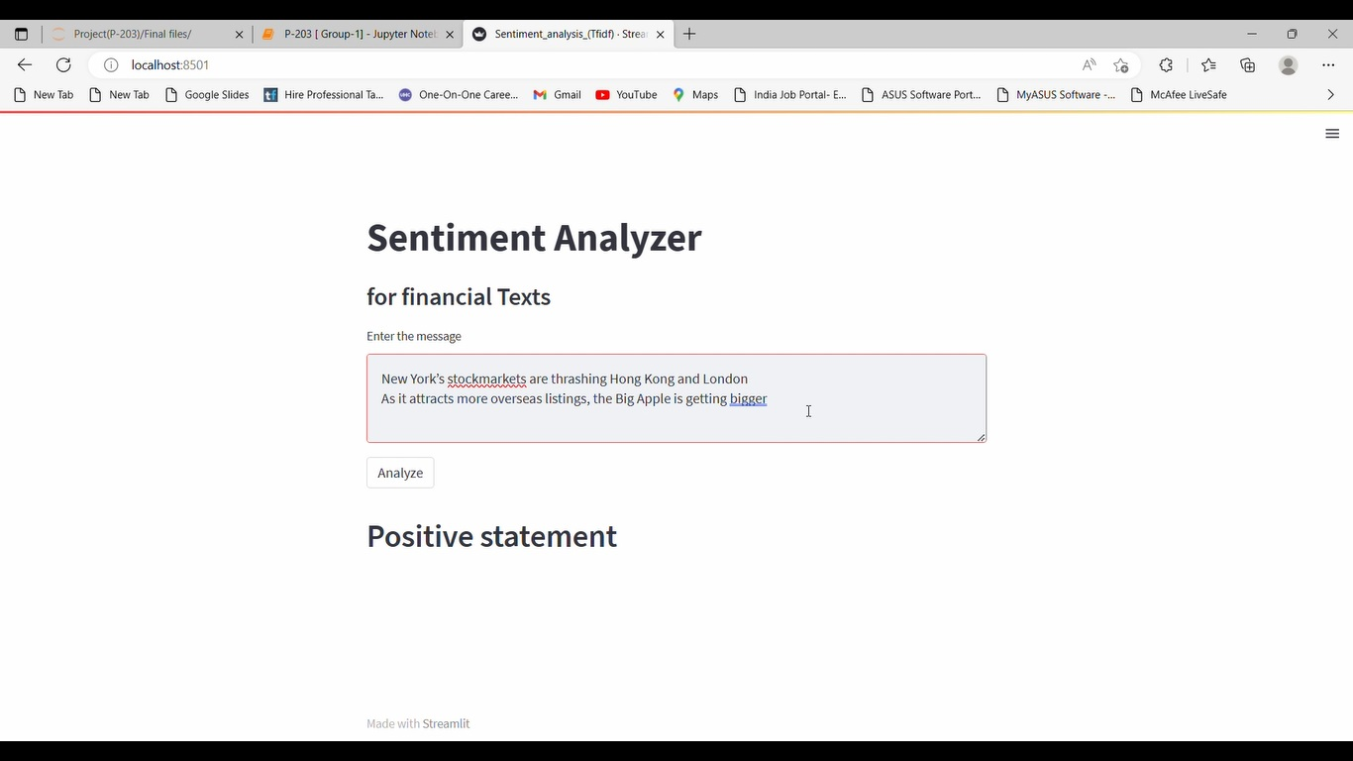
deployment
Carried out with streamlit
Deployment video is also attached
Pickle file is also attached

Slide 26
Thank You

